Slide 1




Question: What is the connection between Micro-credentials / Micro-learning,
Digital Badges and
Micro-learning Employment Xchange© (MEX)?
Short Answer: The Government of Ontario
Long Answer: Read inside
[https://www.ontario.ca/page/micro-credentials-ontarios-postsecondary-schools]
Designed, Developed and Produced by:
Tino Sequeira
Send inquiries to:
tino8466@Right2Write.ca

Slide 2

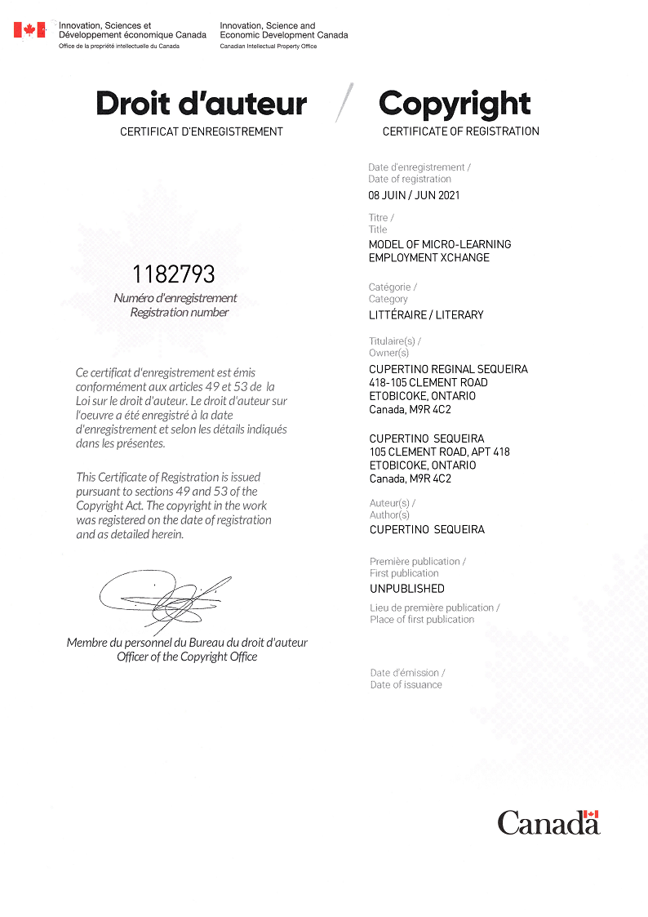
Table of Contents:
Copyright Certificate:
Copyright Certificate
Overview
About the programs
Ontario Micro-credentials Challenge Fund
What are digital badges?
What is Micro-learning Employment Xchange©
Benefits to Employers, Employees, Colleges and the Economy
Sample of digital badge
MEX© Flowchart (Protected)
Prior to using the MEX© model
Questions

Slide 3
Overview
About the programs
Micro-credentials are rapid training programs offered by colleges, universities and Indigenous Institutes across the province that can help you get the skills that employers need. They help people retrain and upgrade their skills to find new employment.
Micro-credential programs:
take less time to complete than degrees or diplomas
may be completed online and may include on-the-job training
many are created with input from business sectors, so the skills being taught match employer needs.

Slide 4
Ontario Micro-credentials Challenge Fund
What are Digital Badges?
[https://teachonline.ca/tools-trends/ten-facts-about-open-digital-badges]
To accelerate the development of micro-credentials and expand program offerings, Ontario is providing $15 million through the Ontario Micro-credentials Challenge Fund.
Ontario postsecondary institutions, working with local industry and employers, can submit a proposal to apply for funding to develop new or to expand existing micro-credentials.
Open badges are portal digital credentials
Open badges are created and issued by a wide variety of organizations, such as colleges, universities and other training providers, professional associations, non-profits and private companies, for their students, members, staff, clients and partners to recognize learning achievements. Below are links to four well-recognized definitions of digital badges:
OpenBadges - https://openbadges.org/get-started
eLearning Industry - https://elearningindustry.com/guideto-digital-badges-how-used
CanCred Factory - https://factory.cancred.ca/faq/#What%20are%20Open%20Badges
MacArthur Foundation - https://www.macfound.org/programs/digital-badges/

Slide 5
𝐖𝐡𝐚𝐭 𝐢𝐬 𝐌𝐢𝐜𝐫𝐨-𝐥𝐞𝐚𝐫𝐧𝐢𝐧𝐠 𝐄𝐦𝐩𝐥𝐨𝐲𝐦𝐞𝐧𝐭 𝐗𝐜𝐡𝐚𝐧𝐠𝐞© (𝐌𝐄𝐗)?
The MEX© Model will target the gaps and the needs that currently exist for several job types. We are using healthcare only as an example. For example, it has been publicized that there is a need to fill the gaps existing in long-term care institutions. Furthermore, there is a gap between the knowledge management of current employees and the skills required by employers. The objective of MEX© is to fill in those gaps with a multi-throng approach graphically described separately.
The jobs from employers will be matched with the skillset of job applicants. If there is a match, MEX© will inform the employer and the job applicant – and the jobs will be filled.
Thus, one segment of the unemployed or underemployed market will be addressed.
.
Changes in the employment market have exposed a vacuum that exists in the job market and training environment. This is mainly due to the COVID-19 pandemic Some of those gaps are:
Employees who are working from home are having challenges documented separately.
Employers need employees who have specific skills and training and hence there are targeted vacancies.
Many employees have been laid off for various reasons and in order to get back to the work force, employers are demanding upskills and additional training.
Unemployment, underemployment, and under-training constantly affect the unemployment rate in Canada.
There is therefore a demonstrated demand for Micro-Learning or Micro-credentials along with immediate job placements.

Slide 6
Benefits of MEX©
Benefits to Employees:
Employees will have peace of mind that their qualifications, experience and skills will be matched to the vacancies currently existing.
Employees whose skills do not match with the vacancies will be able to register with the approved colleges that are able to provide training for those skills.
Employees will get real job-oriented courses once they register with MEX®
Employees are able to maintain a continuous employment history in their résumés since their micro-learning will be part of the ongoing employment history.
Benefits to Employers:
Employers have peace of mind that first of all, their job vacancies will be matched by the MEX® Administrator and thus fill their vacancies sooner than later.
Secondly, they will receive job applicants who have Micro-credentials in exactly the skillset they need.
Employers have reduced training time since their employees from MEX® are trained and ready to take off.
Employers have a good reputation in the industry since they have the right level and quality of staffing.
Employers’ businesses increase since they have a well-structured employment and training policy in place to attract new employees and new clients..

Slide 7
Benefits of MEX©
Benefits to the Economy:
As a result of the MEX® model, the economy flourishes since the unemployment rate will drop.
Stakeholders like employers and the industry in general who register with MEX® will benefit because they are able to get adequately trained employees to meet their specific job demands.
The standard of job-oriented training gets uplifted because any person unemployed once registered with MEX® gets trained in skills that employers need and thus employers are able to absorb those employees quickly in their workforce.
Benefits to Approved Colleges (AC):
Colleges who register with MEX® will have the exquisite opportunity to participate in the Micro-credentials program that has been advocated by Ontario government and thus develop Micro-credential courses to meet the current demands.
Students who register with these colleges will also benefit since they will be registered with MEX® as well.
Approved colleges will have the opportunity to increase the number of courses to meet the demands of Micro-credential courses as confirmed by MEX®.

Slide 8
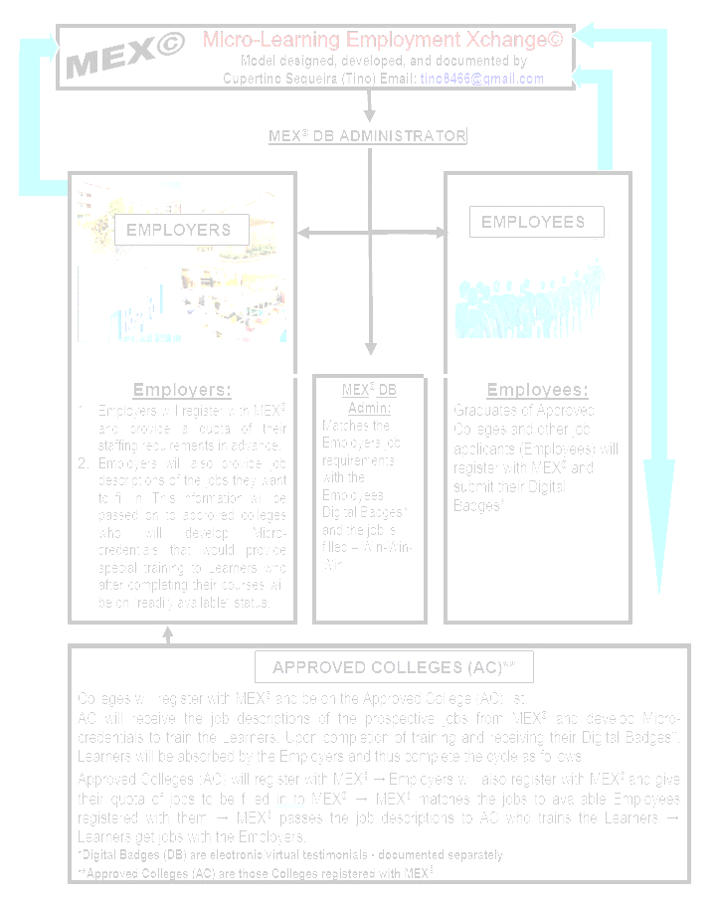
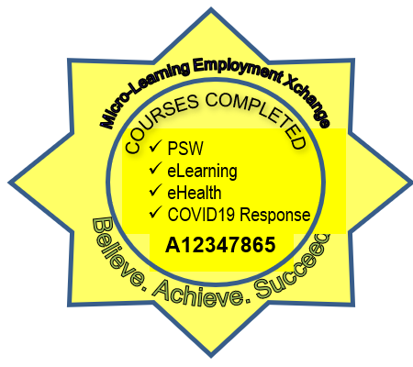
Appendix 1 – Digital Badge
Appendix 2 – MEX© Model Flowchart
Salient aspects of the Digital Badges:
Cloud hosted
Digital portfolio
.png portable
Verification tools to extract the metadata
Customized design of Digital Bades.
PROTECTED
.csv spreadsheet delivered
Social sharing and brand awareness
QR Code
Pathways & stackable Micro-credentials
Blockchain secure

Slide 9
Your Name: ________________________
Your Title: __________________________
Your Organization: ___________________
Your Email: _________________________
Your Phone No.: _____________________
Your Questions: _____________________
Your Comments: _____________________
___________________________________
___________________________________
Prior to using the MEX© Model:
For more documentation on the MEX© Model, please send us your information
[P.S. If you need help to implement the MEX© model along with the associated databases, in your organization – and see the results - please mention in the Comments]

Slide 10
The MEX© Model has been developed and presented by:
Questions??
If you have any questions or need more details, please complete the form on slide 9 and, email me at:
tino8466@Right2Write.ca
Sweet Dreams by BatchBug | https://soundcloud.com/batchbug
Music promoted by https://www.chosic.com
Creative Commons Attribution 3.0 Unported License
https://creativecommons.org/licenses/by/3.0/deed.en_US
Tino Sequeira
Wellness Coach
Speaker
Remote Writer
(www.info2wrirw.com)
Business Owner
The MEX© model has been researched, designed and developed by Tino Sequeira. We respect your need for further information and would request you to complete the form on slide 9 if you would like more detailed information.

